Slide 1
spinny.com
SEO & Competitive Intelligence Report
Traffic Analysis · Keyword Strategy · Competitor Landscape
99%
196K
388K
$1.52M
Organic Traffic
Organic Keywords
Monthly SEO Clicks
Estimated Ad Budget

Slide 2
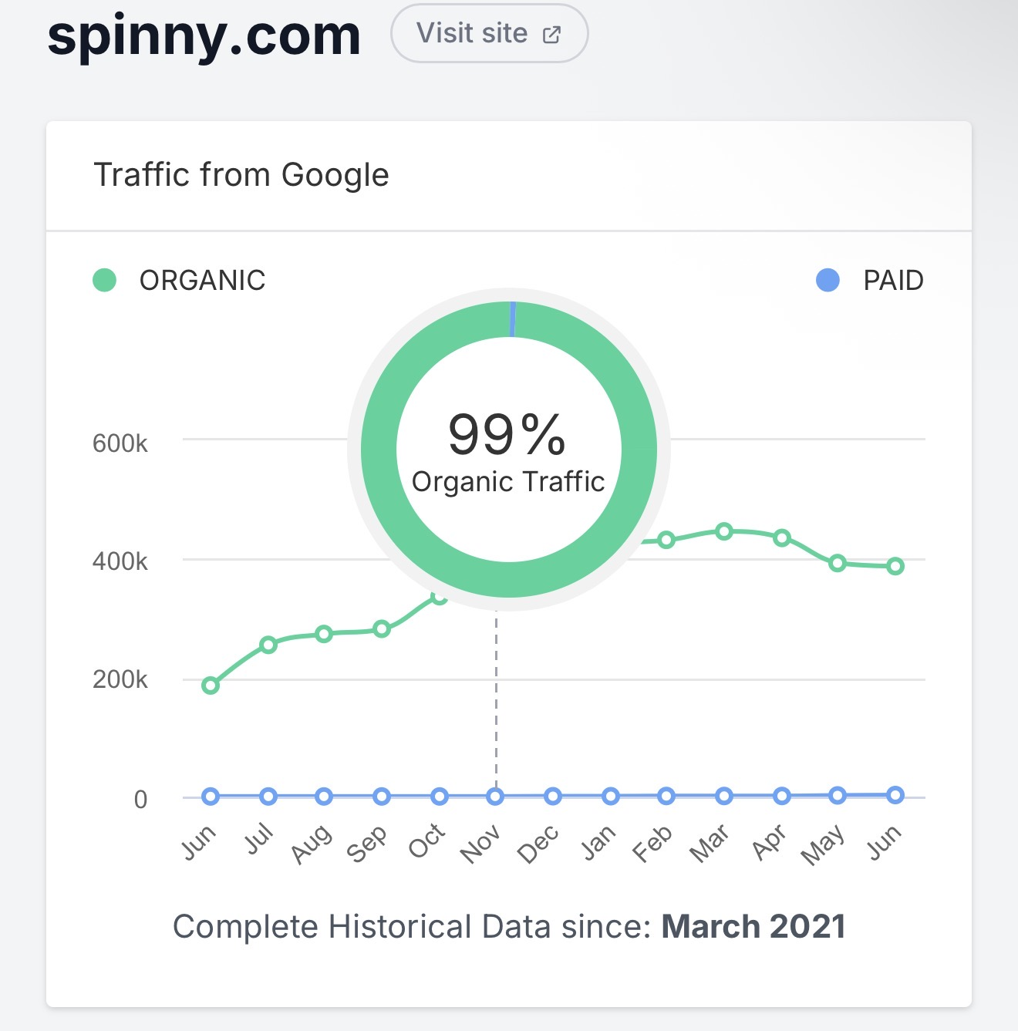
Traffic from Google
Organic vs Paid Search — spinny.com
99%
Organic Traffic Share
~400K
Peak Monthly Organic Visits
~0%
Paid Traffic Share
Data source: Semrush / SpyFu | Historical data since March 2021

Slide 3
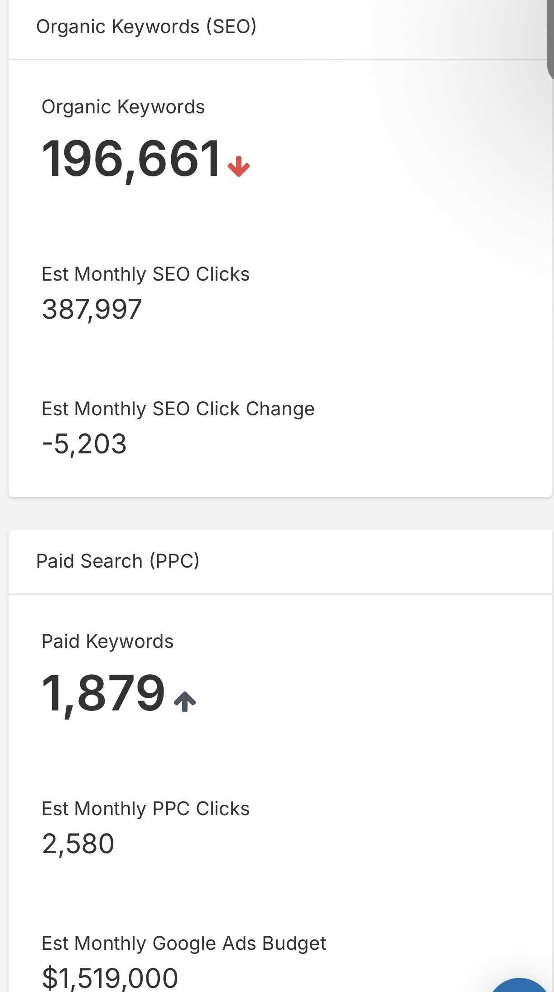
Organic & Paid Search Metrics
SEO (Organic)
Organic Keywords
196,661 ↓
Est. Monthly SEO Clicks
387,997
Monthly SEO Click Change
–5,203
PPC (Paid)
Paid Keywords:
1,879 ↑
Est. Monthly PPC Clicks:
2,580
Est. Monthly Google Ads Budget:
$1,519,000

Slide 4
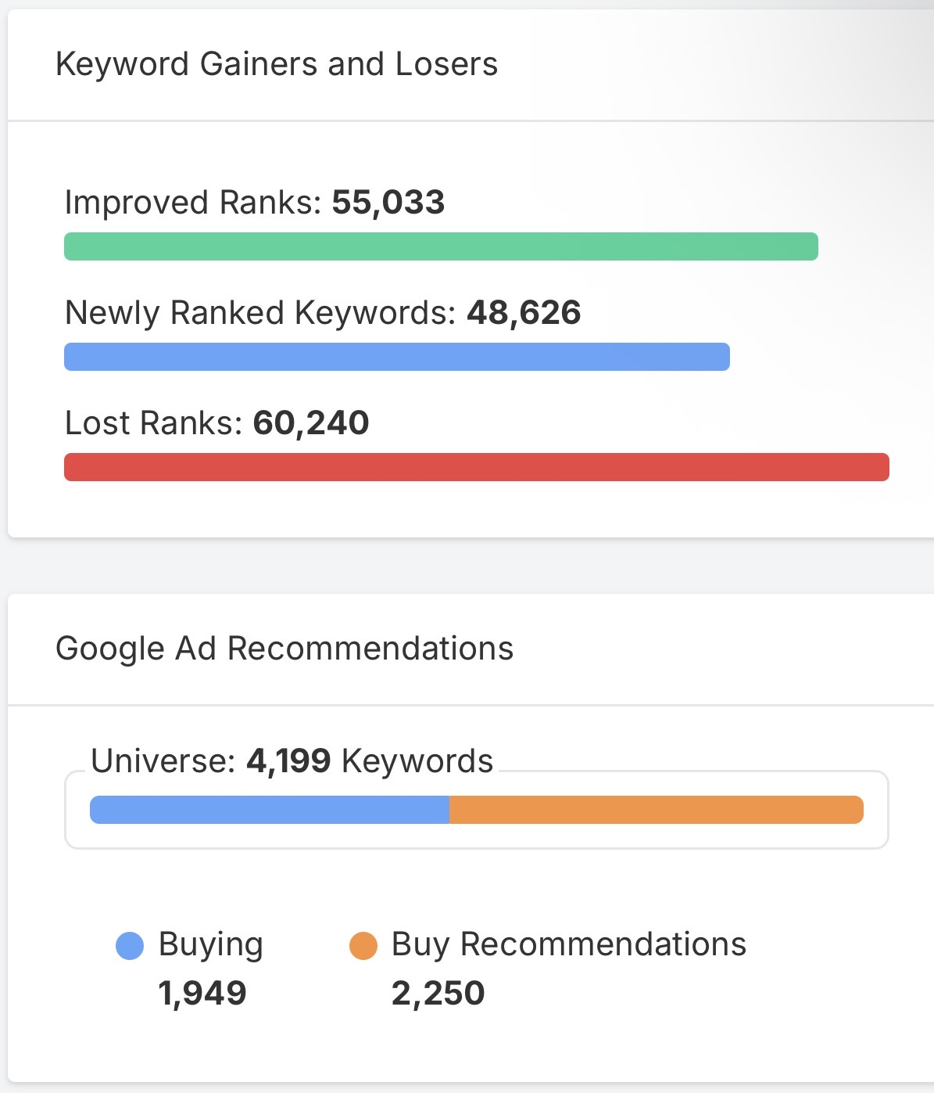
Keyword Gainers & Losers
55,033
48,626
Improved Ranks
Newly Ranked Keywords
60,240
4,199 kw
Lost Ranks
Google Ad Universe
1,949
2,250
Buying Keywords
Buy Recommendations

Slide 5
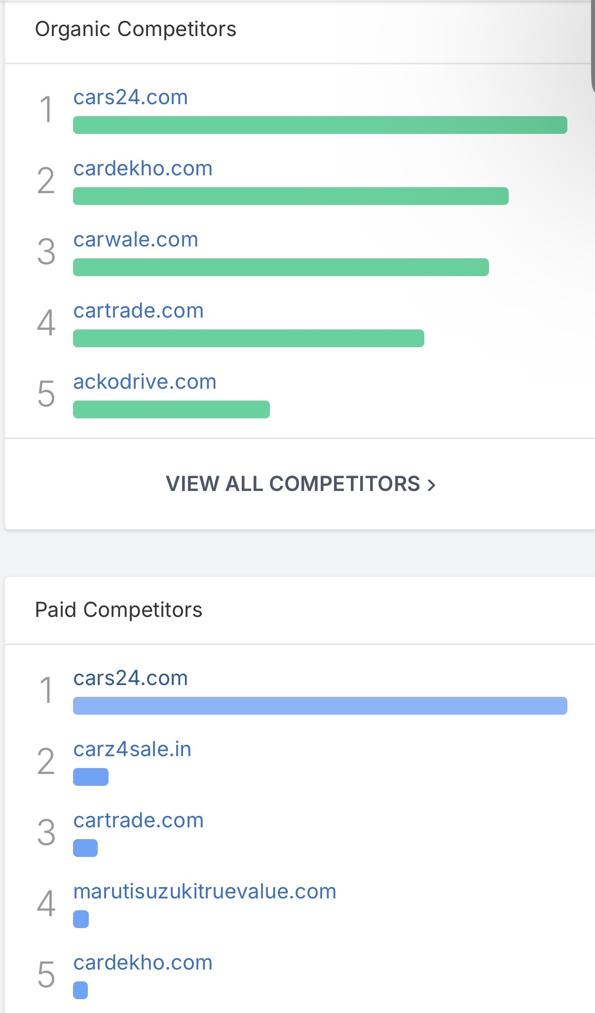
Competitor Landscape
Top Organic Competitors
1. cars24.com
2. cardekho.com
3. carwale.com
4. cartrade.com
5. ackodrive.com
Top Paid Competitors
1. cars24.com
2. carz4sale.in
3. cartrade.com
4. marutisuzukirtruevalue.com
5. cardekho.com

Slide 6
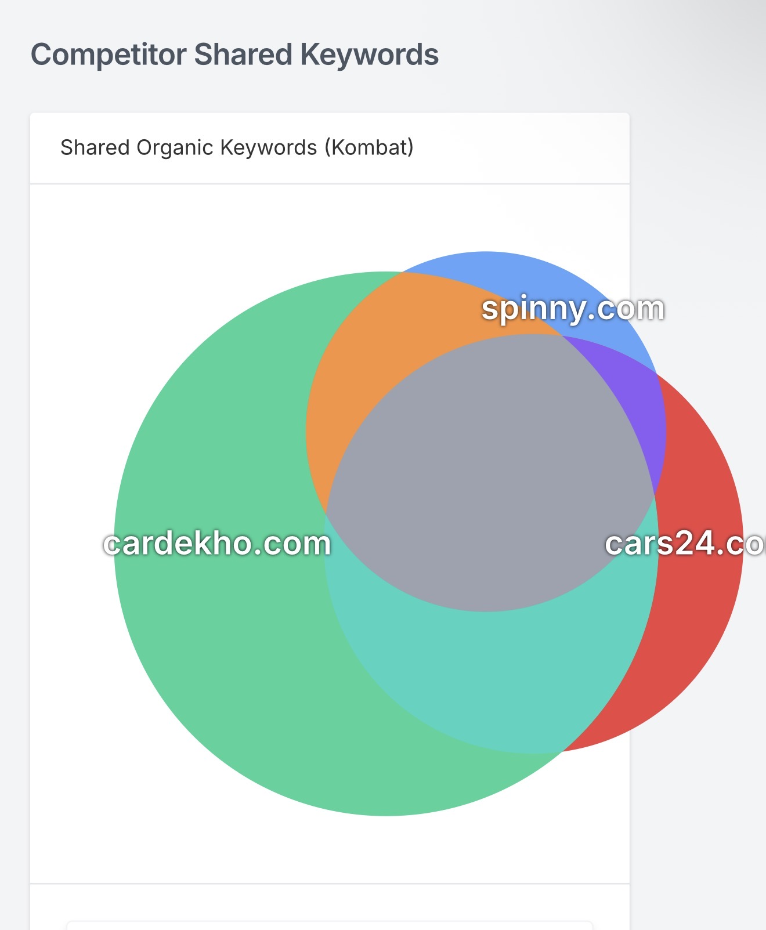
Competitor Shared Keywords
Shared Organic Keywords (Kombat) — spinny.com vs cardekho.com vs cars24.com
Keyword Universe
All Keywords
237K
38.8M searches
Core Keywords
56.4K
10.5M searches
Questions
3.54K
171K searches
Missing Keywords
37.3K
6.16M searches

Slide 7
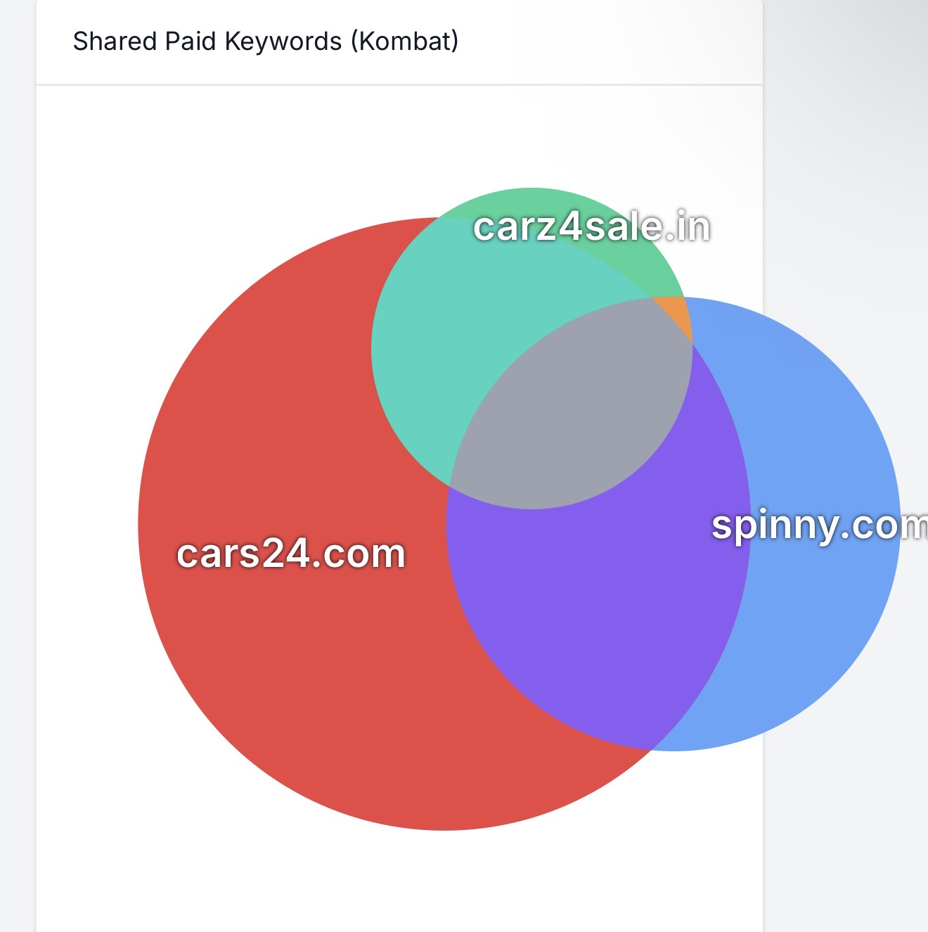
Shared Paid Keywords
Paid Keyword Overlap (Kombat) — spinny.com vs cars24.com vs carz4sale.in
PPC Keyword Buckets
All Keywords
4.2K
1.87M monthly clicks
Core Keywords
134
33.9K monthly clicks
Consider Buying
70
290 monthly clicks
Potential Ad Waste
680
120K monthly clicks

Slide 8
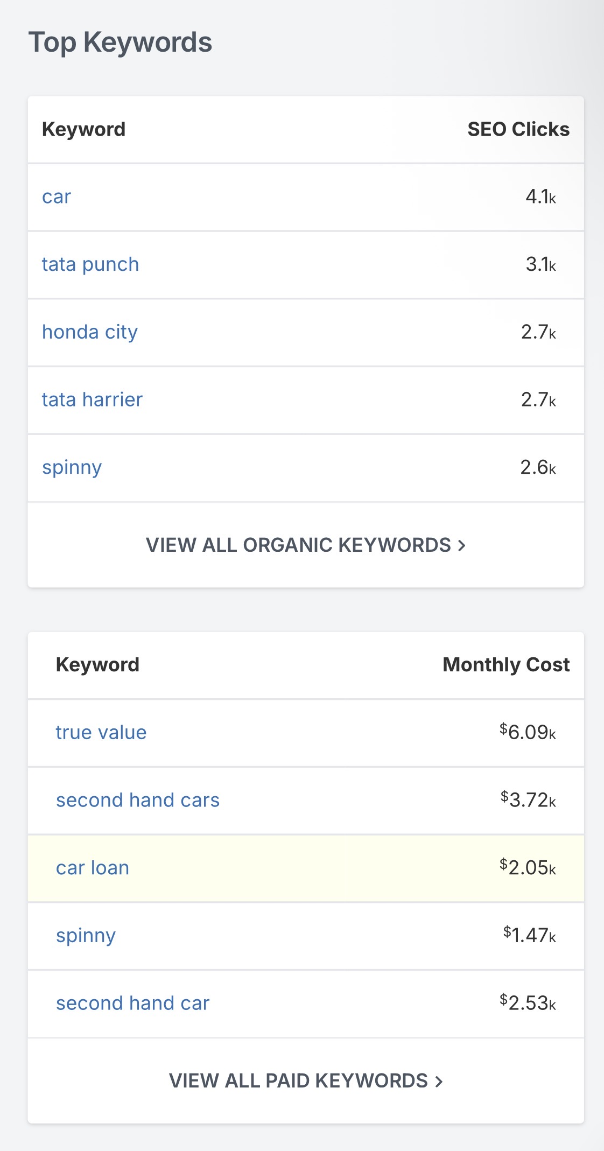
Top Keywords
Top Organic Keywords (by SEO Clicks)
car
4.1K
tata punch
3.1K
honda city
2.7K
tata harrier
2.7K
spinny
2.6K
Top Paid Keywords (by Monthly Cost)
true value
$6.09K
second hand cars
$3.72K
car loan
$2.05K
second hand car
$2.53K
spinny
$1.47K

Slide 9
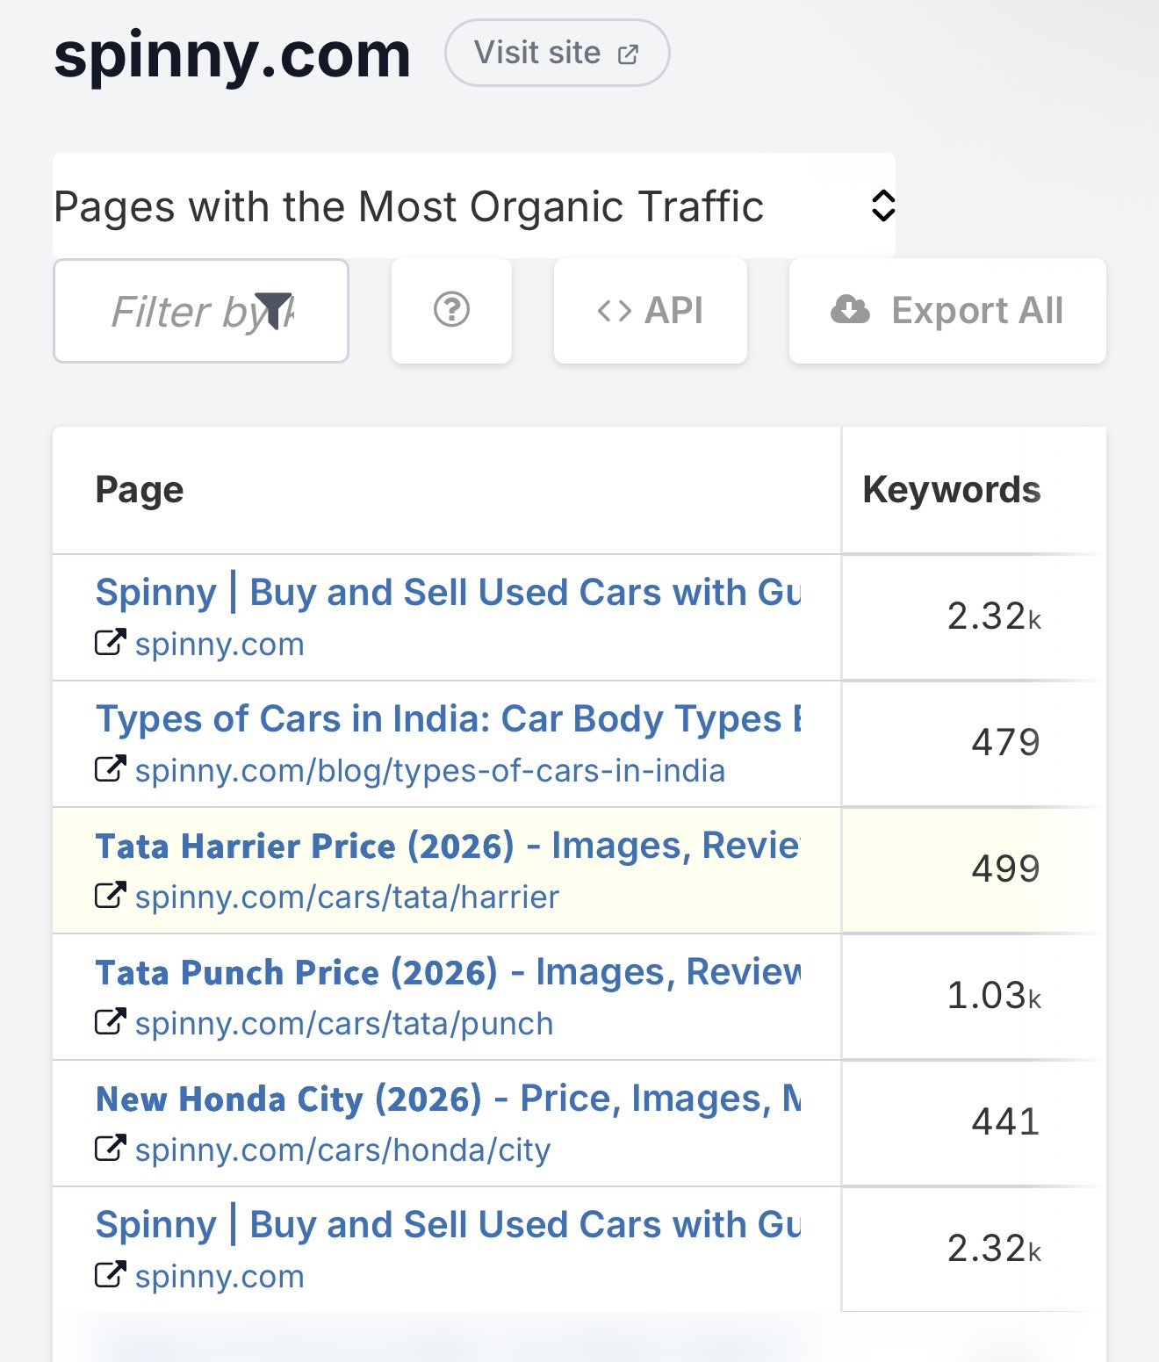
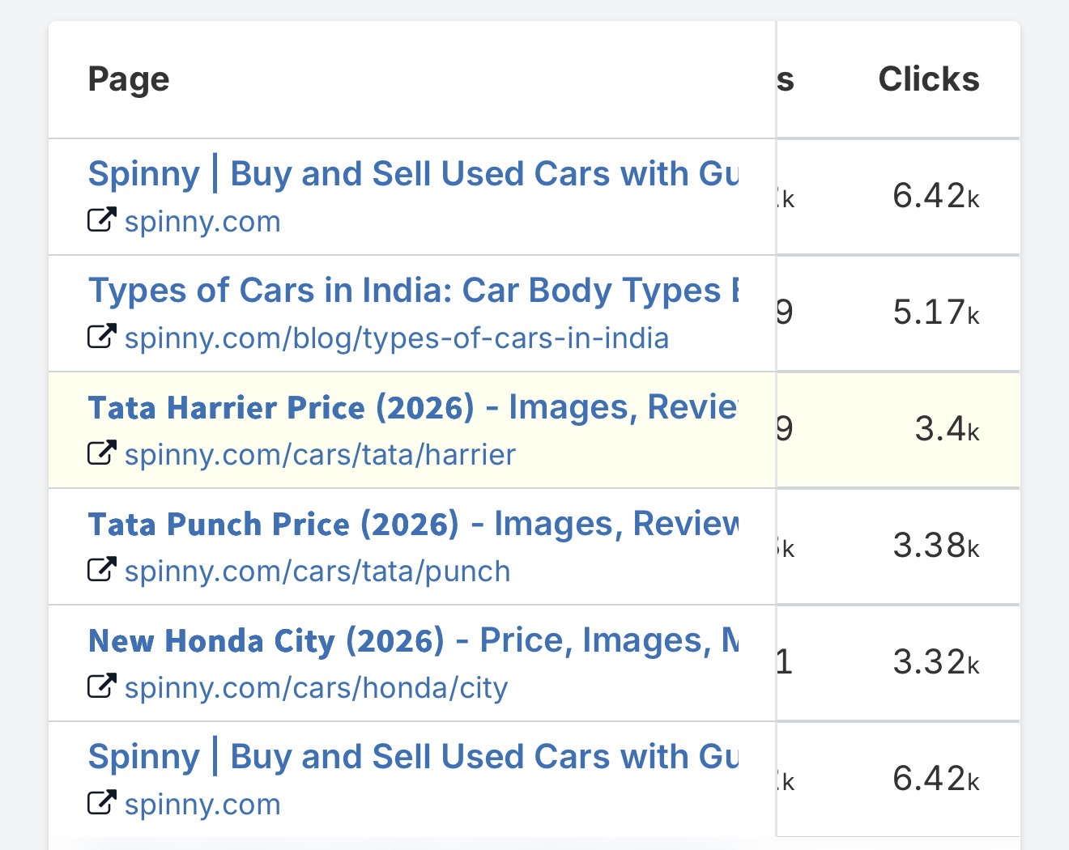
Top Performing Pages
Pages with the Most Organic Traffic & Clicks
Homepage drives 6.42K clicks | Tata model pages are top performers

Slide 10
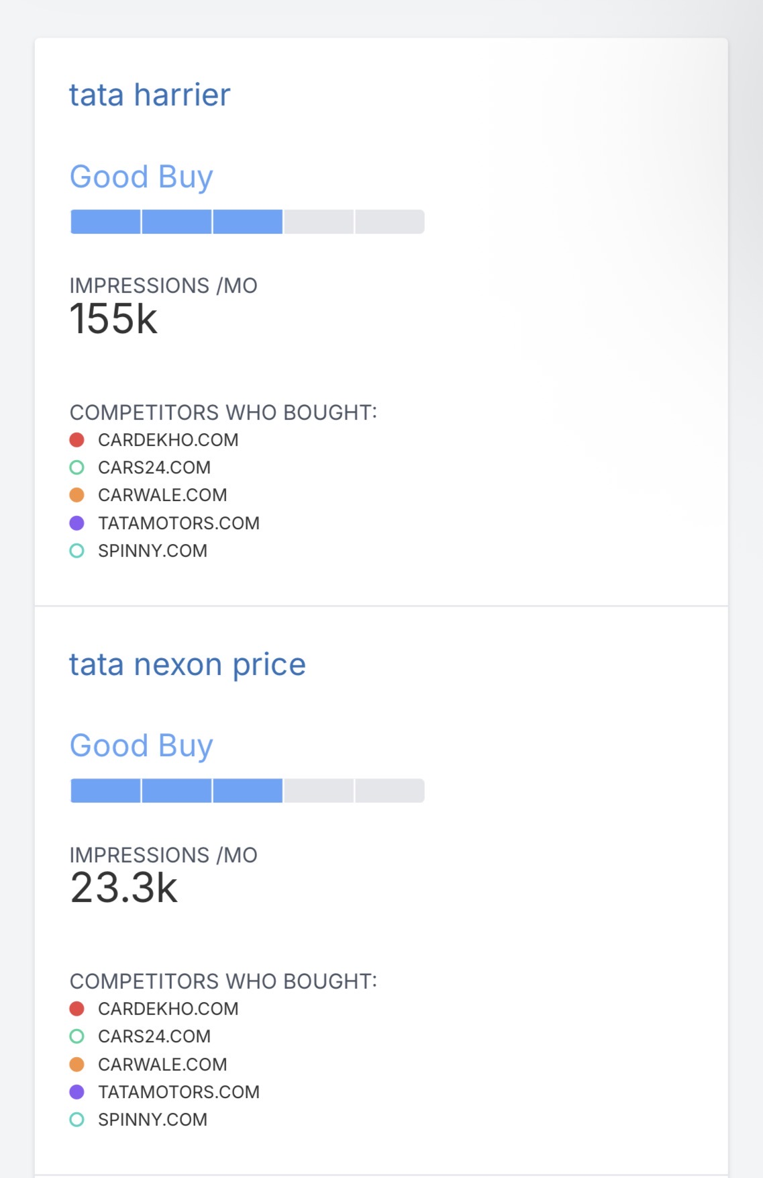
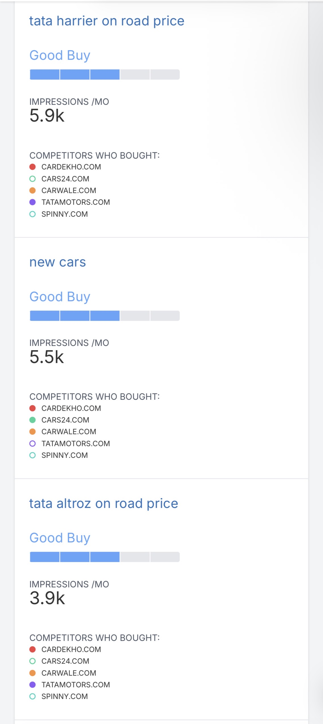
Google Ad Recommendations
High-impression keywords where competitors are buying ads — opportunity for Spinny

Slide 11
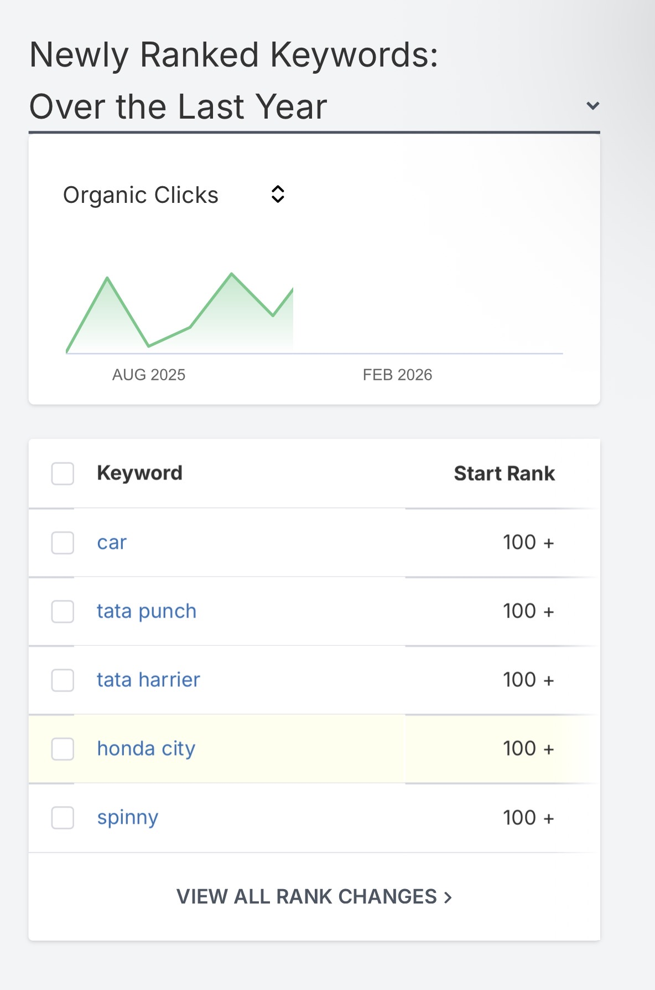
Newly Ranked Keywords
Keywords that entered rankings over the last year (Aug 2025 – Feb 2026)
Key Insights
Brand + Model Keywords
car, tata punch, tata harrier, honda city, spinny all entered from 100+ rank
Strong SEO Recovery
Organic clicks show dual peaks (Aug 2025 & Feb 2026), signaling content momentum
48,626 New Rankings
Significant keyword expansion in the trailing 12 months

Slide 12
Key Takeaways
🟢 Organic Dominance
🏁 cars24.com is #1 Rival
Spinny derives 99% of Google traffic organically — strong SEO moat, minimal paid dependency.
Dominates both organic and paid competitor lists — primary benchmark to track.
📉 Keyword Rank Erosion
🚀 37.3K Missing Keywords
60,240 lost ranks vs 55,033 gained — net negative; content refresh opportunity.
6.16M search volume untapped — significant content gap to close.
💰 High PPC Potential
$1.52M estimated ad budget signals strong paid opportunity in used-car segment.

